Slide 1
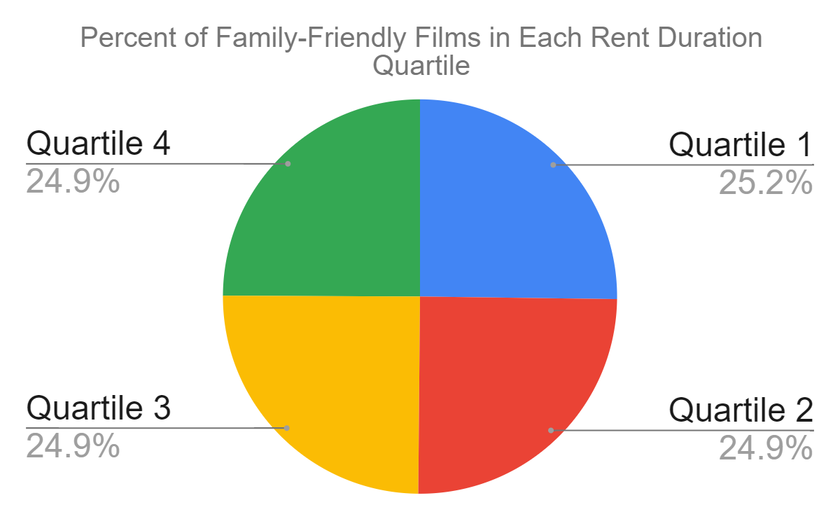
What is the distribution of family-friendly films through rental duration quartiles?
<visualization>
We can see that family-friendly films are evenly spread out through the rental duration quartiles(relative to all films).

Slide 2
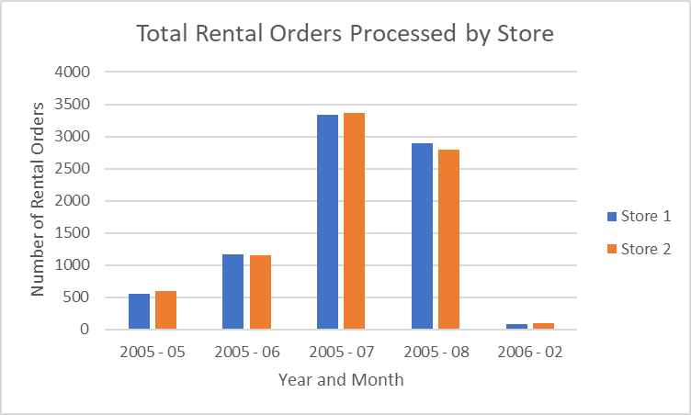
How many rental orders is each store fulfilling per month?
<visualization>
We can see that both stores filled out an equal number of rental orders for each time period.

Slide 3
What do the monthly spending habits of our top ten customers look like?
We can see the AVG monthly payment count, total number of payments, AVG monthly payment amount, and monthly MIN/MAX payment amounts. Customers are ordered by avg_month_pay.
<visualization>

Slide 4
How do genres rank based on the number of rentals from the top 10 paying customers?
<visualization>
This table shows ranking of genres based on the number of times a genre was rented out by your top 10 paying customers.

